Slide 1
Chapter 5
QA Test Plan and Test Cases

Slide 2
Contents
Test Plan Document
How to write Test Plan
What is a Scenario?
What is a Test Case?
What is the Test case format?
Types of Testing and when to do it?
What is RTM?

Slide 3
What is a Test Plan Document?
a detailed document that describes the test strategy, objectives, schedule, estimation and deliverables and resources required for testing.
helps us determine the effort needed to validate the quality of the application under test.
serves as a blueprint to conduct software testing activities as a defined process which is minutely monitored and controlled by the test manager.

Slide 4
Importance of Test Plan
Help define project requirements, identify weaknesses and inconsistencies,
Provide data about the level of quality and test a product during all stages of software dev. lifecycle.
Only code-based tests aren’t enough, QA provides a creative human element, enhancing the success of coded tests.

Slide 5
How to write a Test Plan
Analyze the product (Architechture, users, purpose, workflow, SR/HR requirements)
Design the Test Strategy (scope, types, issues, Logistics)
Define the Test Objectives
Define Test Criteria (80%-100% of test cases coverage)
Resource Planning (HR, SR)
Plan Test Environment (Test team-Dev Team)
Schedule & Estimation (Include test-time In timeline)
Determine Test Deliverables (documents, tools, components ) Important Link: Detailed briefing for each of the points above
TEST PLAN SAMPLE

Slide 6
Test Deliverable Components
1. Test deliverables are provided before testing phase.
Test plans document.
Test cases documents
2. Test deliverables are provided during the testing
Test Scripts
Test Data
Error logs and execution logs.
3. Test deliverables are provided after the testing cycles is over.
Test Results/reports
Defect Report
Installation/ Test procedures guidelines
Release notes

Slide 7
What is a Scenario
An action the user may undertake with a website or app
A situation the user may find themselves in while using that software.
Created to ensure that every single functionality offered by a website or app is working as expected.

Slide 8
Why create a Test Scenario
Creating Test Scenarios ensures complete Test Coverage
Customers to ensure the Application Under Test is thoroughly tested. It ensures that the software is working for the most common use cases.
They serve as a quick tool to determine the testing work effort and accordingly create a proposal for the client or organize the workforce.
They help determine the most important end-to-end transactions or the real use of the software applications.
For studying the end-to-end functioning of the program, Test Scenario is critical.

Slide 9
When Not to Create Test Scenarios
The Application Under Test is complicated, unstable and there is a time crunch in the project.
Projects that follow Agile Methodology like Scrum, Kanban may not create Test Scenarios.
Test Scenario may not be created for a new bug fix or Regression Testing. In such cases, Test Scenarios must be already heavily documented in the previous test cycles. This is especially true for Maintenance projects.

Slide 10
How to create a Test Scenario
Step 1. Carefully study the Requirement Document – Business Requirement Specification (BRS), Software Requirement Specification (SRS), Functional Requirement Specification (FRS)
Step 2. identify what possible user actions need to be tested for it. Figure out the technical issues associated with the requirement. Also, remember to analyze and frame possible positive and negative scenarios.
Step 3. Enumerate test scenarios that cover every possible feature of the software. Ensure that these scenarios cover every user flow and business flow involved in the operation of the website or app.
Step4. After listing the test scenarios, create a Traceability Matrix to ensure that every requirement is mapped to a test scenario.
Step 5. Get the scenarios reviewed by a supervisor, and then push them to be reviewed by other stakeholders involved in the project.

Slide 11
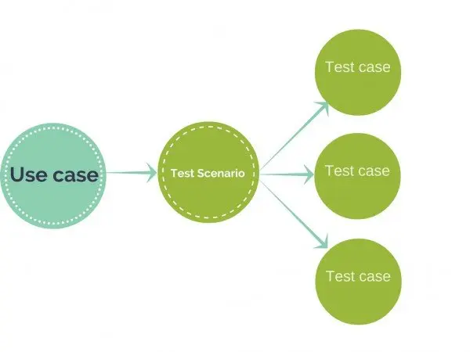
What is Test Case?
A Test Case is a set of actions executed to verify a particular feature or functionality of your software application.
Compares Expected and Actual results

Slide 12
A typical Test Case contains:
TC_Name
Format:TC_Module_SubmoduleName_Functionality
Test Scenario
Type
Steps
Description
Expected result
Execute
Actual Result
Status
(Pass/ Fail)

Slide 13
Example 1: Test Scenario for eCommerce Application
Test Scenario 1: Check the Login Functionality
Specific Test Cases for this Test Scenario would be
Check system behavior when valid email id and password is entered.
Check system behavior when invalid email id and valid password is entered.
Check system behavior when valid email id and invalid password is entered.
Check system behavior when invalid email id and invalid password is entered.
Check system behavior when email id and password are left blank and Sign in entered.
Check Forgot your password is working as expected
Check system behavior when valid/invalid phone number and password is entered.
Check system behavior when “Keep me signed” is checked
Note: As evident, Test Cases are more specific.

Slide 14
Test Scenario & Test Cases
2. Test Scenario 2:Check the Search Functionality
3. Test Scenario 3: Check the Product Description Page
4. Test Scenario 4: Check the Payments Functionality
5. Test Scenario 5: Check the Order History
6. Test Scenario 6 :Check Home Page behavior for returning customers
7. Test Scenario 7: Check Category/Product Pages
8. Test Scenario 8: Check Customer Service/Contact Pages
9. Test Scenario 9: Check Daily Deals pages
Test Scenario Template

Slide 15
Example of Test case
Test Case Example 1
Test Case Example 2

Slide 16
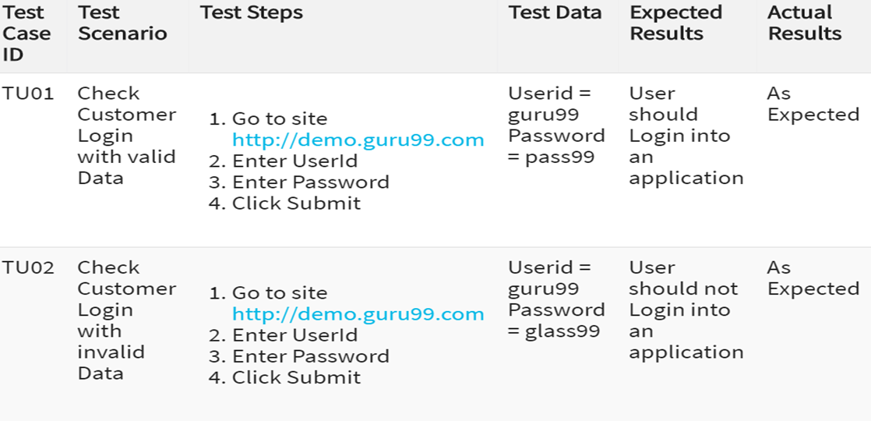
Test case covering login page

Slide 17
What is Requirements Traceability Matrix (RTM)?
A Traceability Matrix is a document that co-relates any two-baseline documents that require a many-to-many relationship to check the completeness of the relationship.
It is used to track the requirements and to check the current project requirements are met.
Requirement Traceability Matrix?
RTM is a document that maps and traces user requirement with test cases.
It captures all requirements proposed by the client and requirement traceability in a single document, delivered at the conclusion of the Software development life cycle.
The main purpose of RTM is to validate that all requirements are checked via test cases such that no functionality is unchecked during Software testing.

Slide 18
What is Requirements Traceability Matrix (RTM)?
Importance:
A simple way is to trace the requirement with its corresponding test scenarios and test cases.
Types and How to Create RTM

Slide 19
Assignment
Write scenarios and test case of the test site(atleast 10 scenarios) (https://www.demoblaze.com/index.html)

Slide 20
Link for Practice and Learning
https://www.demoblaze.com/index.html
https://www.applause.com/blog/functional-testing-types-examples
https://www.parasoft.com/blog/how-to-write-test-cases-for-software-examples-tutorial/
https://bambooagile.eu/insights/what-is-stlc/
https://medium.com/@concisesoftware/everything-you-should-know-about-qa-in-software-development-the-beginners-guide-3e7afacf607c
https://www.guru99.com/what-everybody-ought-to-know-about-test-planing.html
https://www.guru99.com/test-scenario.html
https://www.guru99.com/traceability-matrix.html

Slide 21
THANK YOU!!
ANY QUERIES?

